Slide 1
AIDI1012 - 23W AI Robotics and Automation Assignment 2
A3 Group Members
Shivani Bajaj(200527764)
Cheuk Ying Iu(200514612)
Fangji Chen(200520598)
Ayesha Siddiqa(200502171)
Taekeon Kim(200452564)
Shivansh Setia(200511522)
Harshal Shashikant Bhasgauri(200499159)
Hamza Kadodia(200535827)
Sahil Singal( 200506536)
Himanshu (200535823)

Slide 2
Part 1

Slide 3
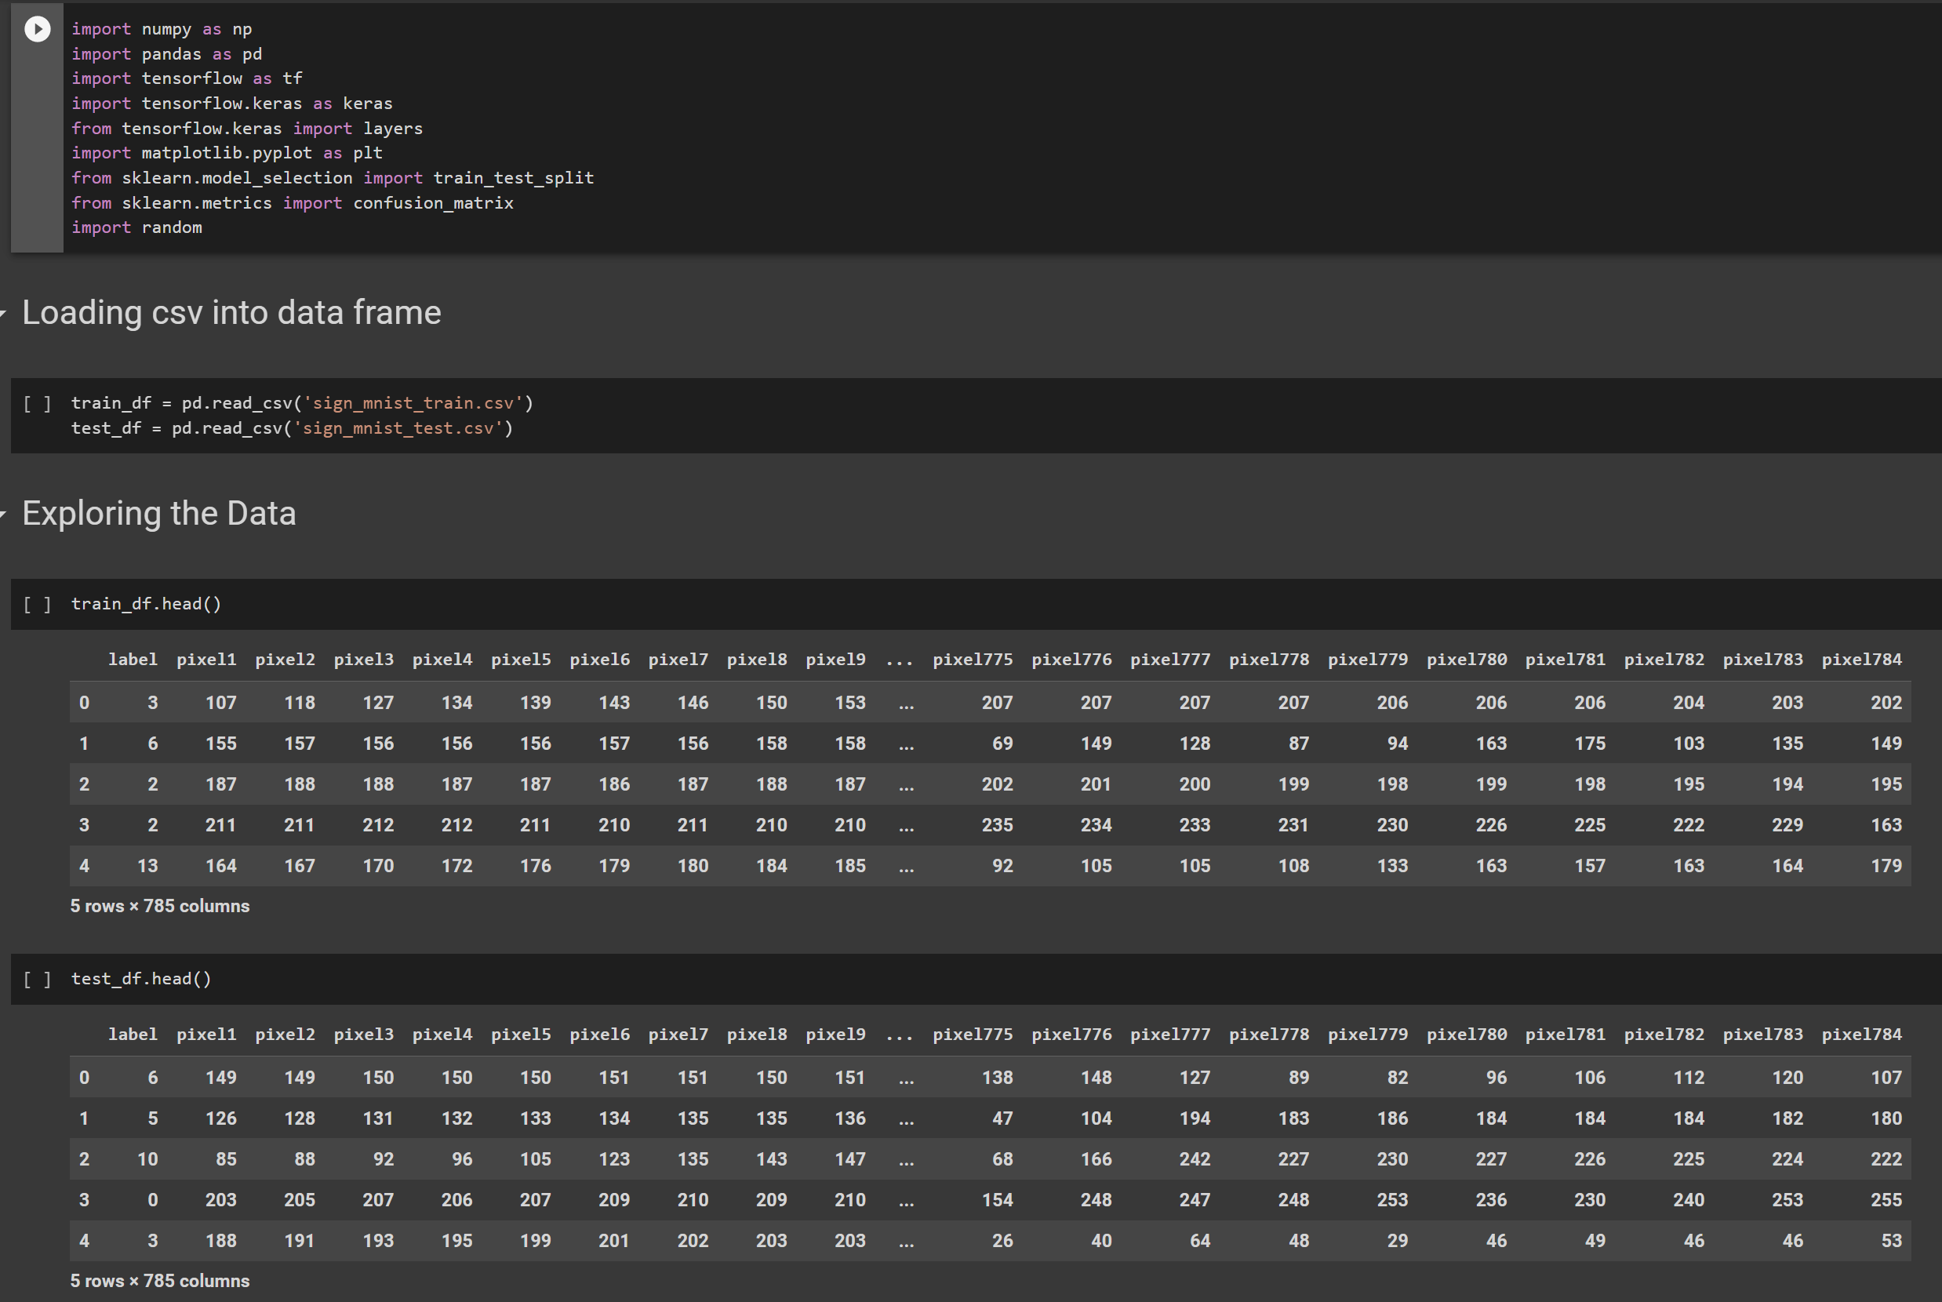
Part 1 Image Classification of an American Sign Language

Slide 4
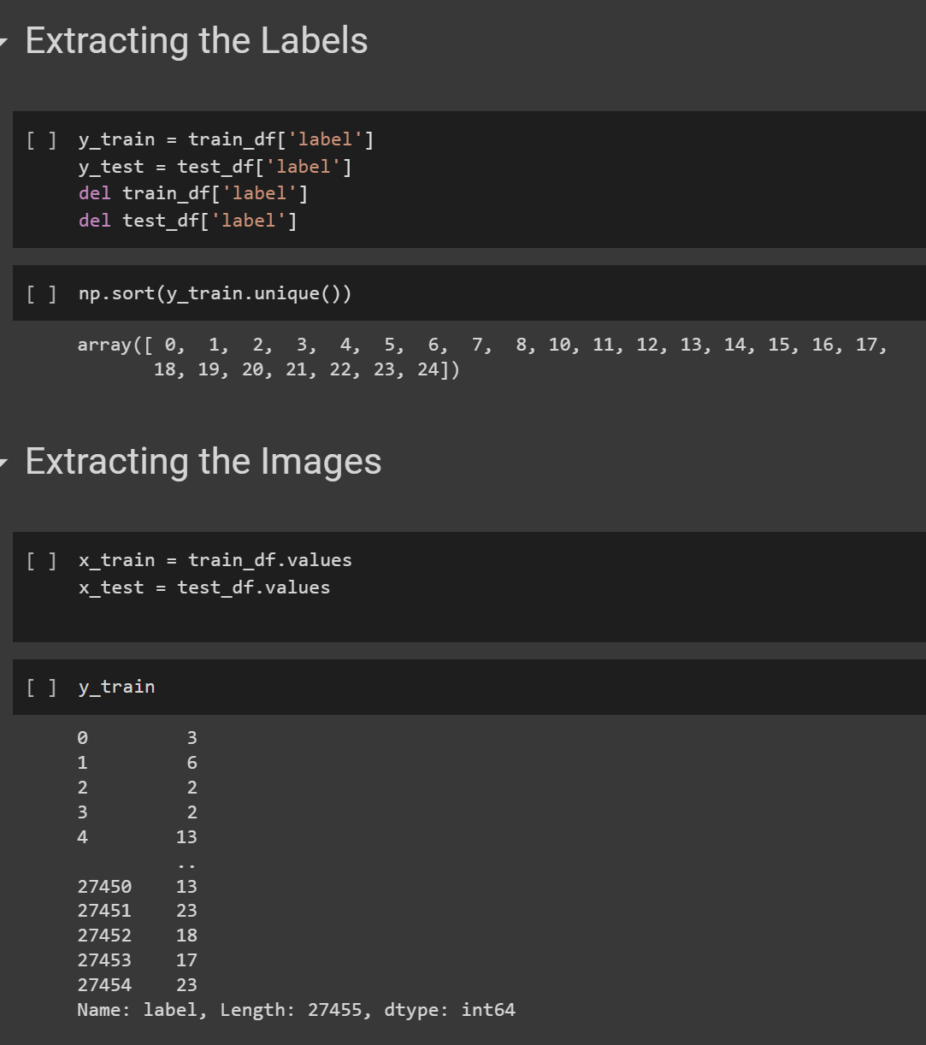
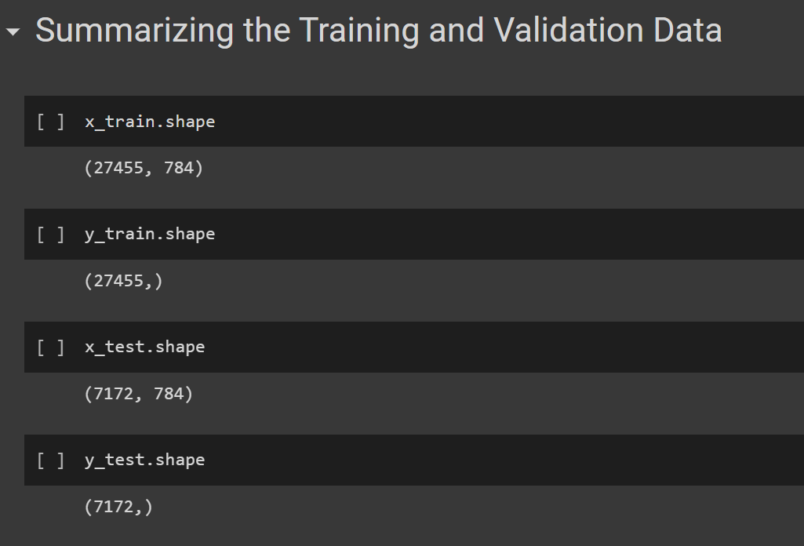
Part 1 Image Classification of an American Sign Language

Slide 5
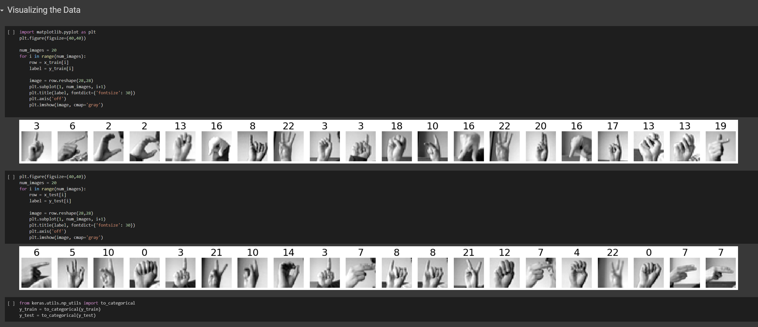
Part 1 Image Classification of an American Sign Language

Slide 6
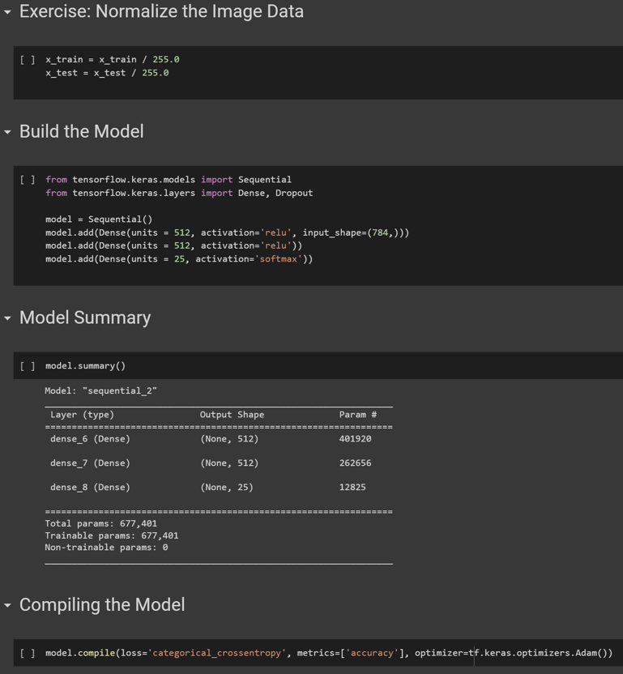
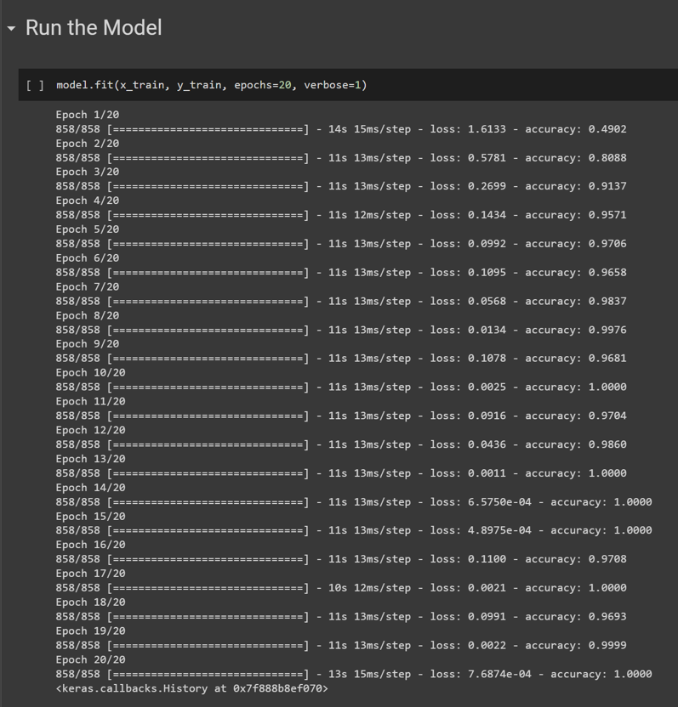
Part 1 Image Classification of an American Sign Language

Slide 7
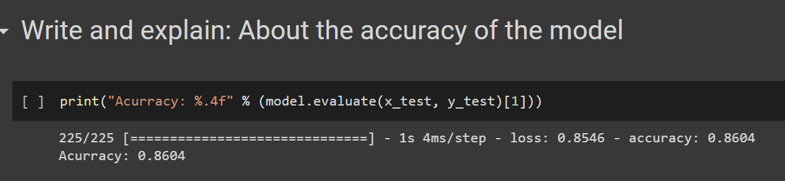
Part 1 Image Classification of an American Sign Language

Slide 8
Part 2

Slide 9
Launch

Slide 10
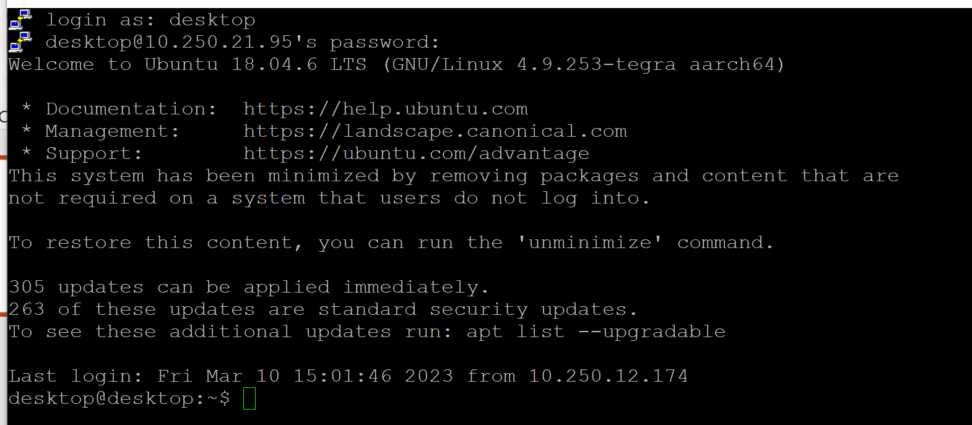
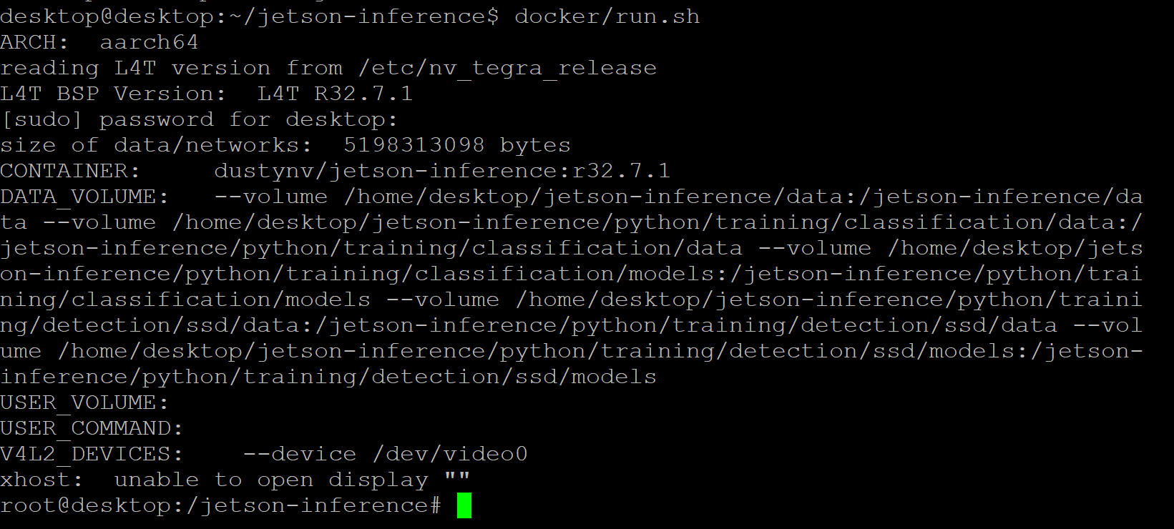
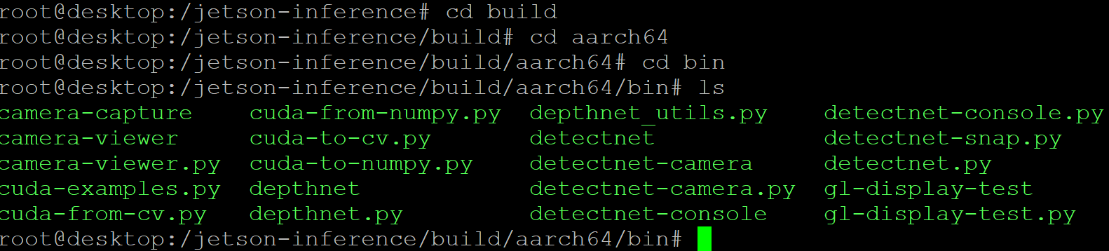
Explain about steps to Launch the container and issues to run the container
1.Login
3. Docker
2. Jetson-inference
4. build/aarch64/bin → file included

Slide 11
Image Classification
Follow the instruction at :
https://github.com/dusty-nv/jetson-inference/blob/master/docs/imagenet-example-python-2.md

Slide 12
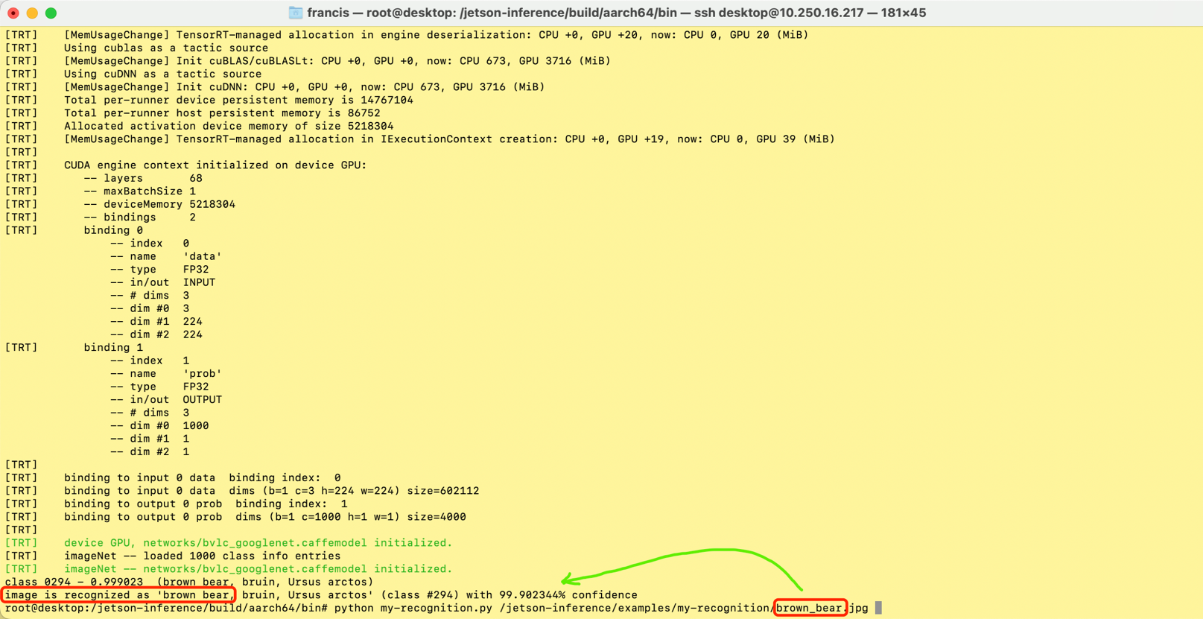
Image Classification for a brown_bear
python my-recognition.py /jetson-inference/examples/my-recognition/brown_bear.jpg

Slide 13
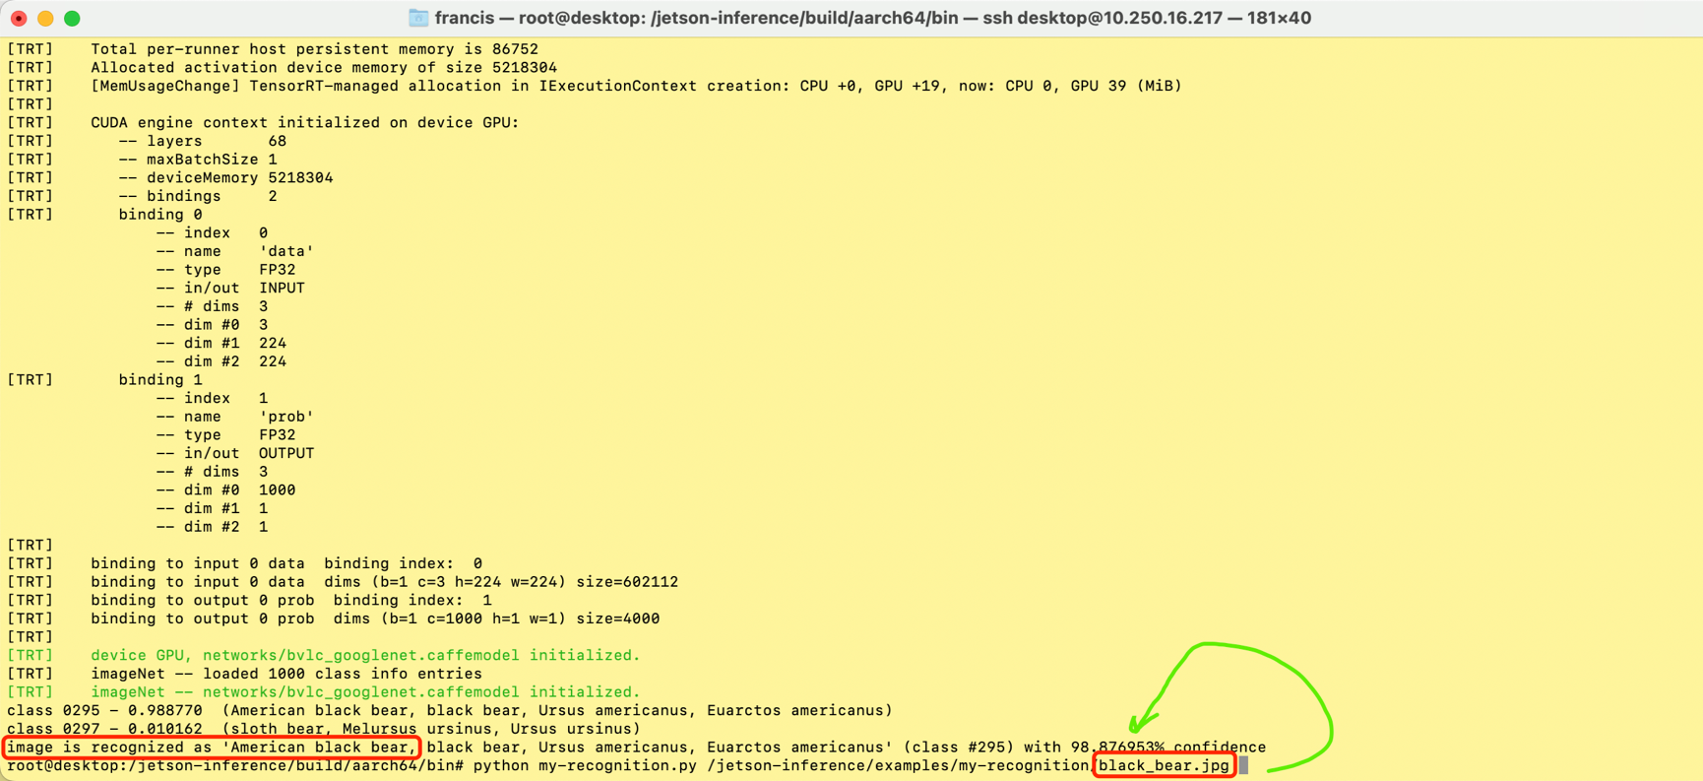
Image Classification for a black_bear
python my-recognition.py /jetson-inference/examples/my-recognition/black_bear.jpg

Slide 14
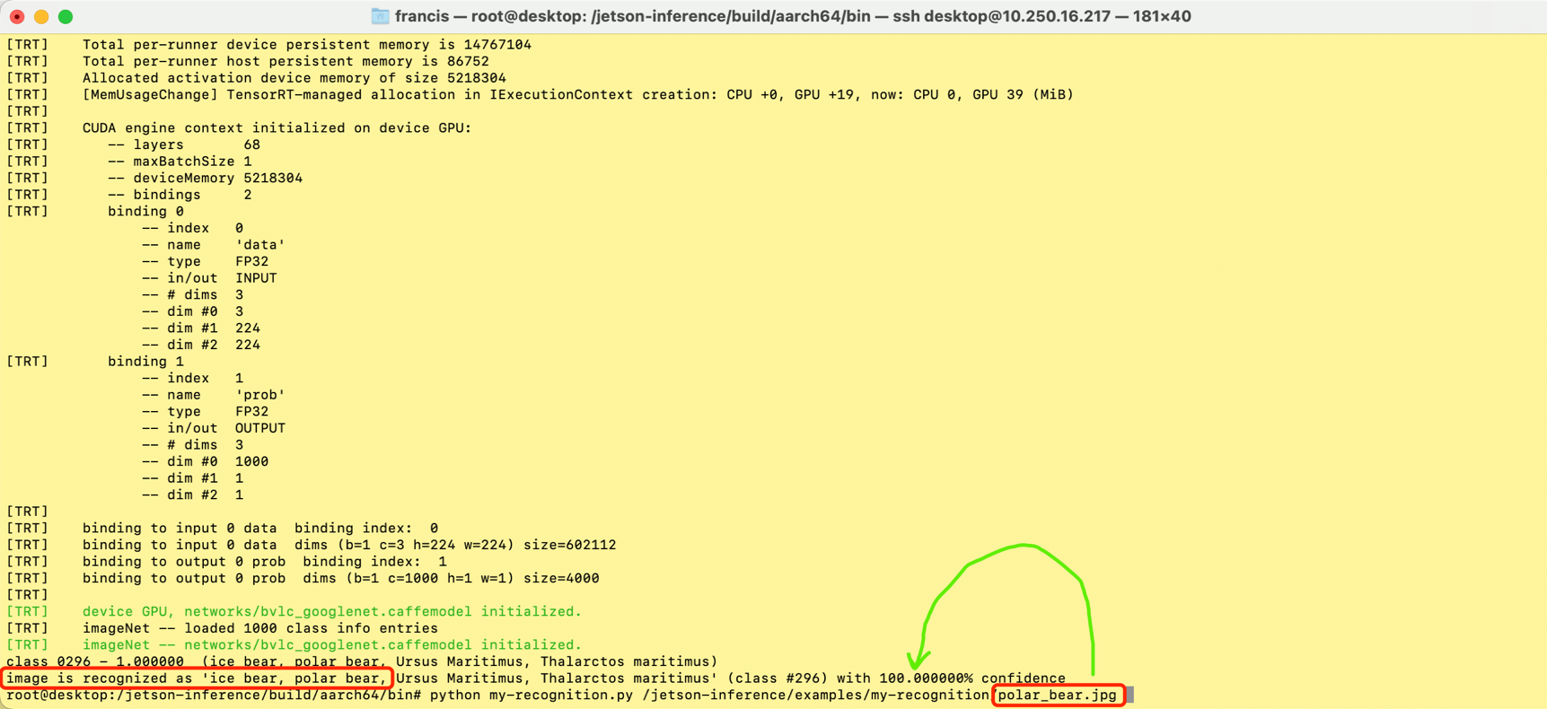
Image Classification for a polar_bear
python my-recognition.py /jetson-inference/examples/my-recognition/polar_bear.jpg

Slide 15
Image segmentation
Follow the instruction at :
https://github.com/dusty-nv/jetson-inference/blob/master/docs/segnet-console-2.md

Slide 16
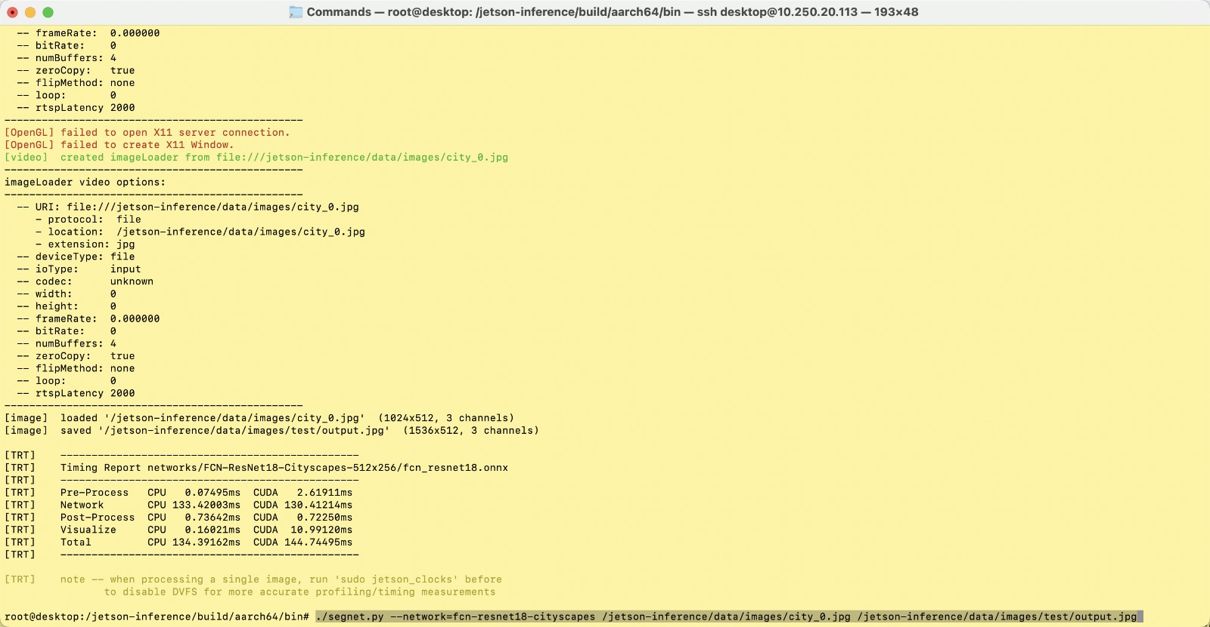
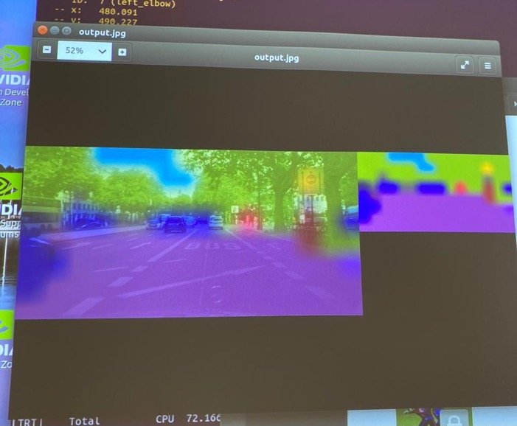
Image Segmentation with fcn-resnet18-cityscapes
./segnet.py --network=fcn-resnet18-cityscapes /jetson-inference/data/images/city_0.jpg /jetson-inference/data/images/test/output.jpg

Slide 17
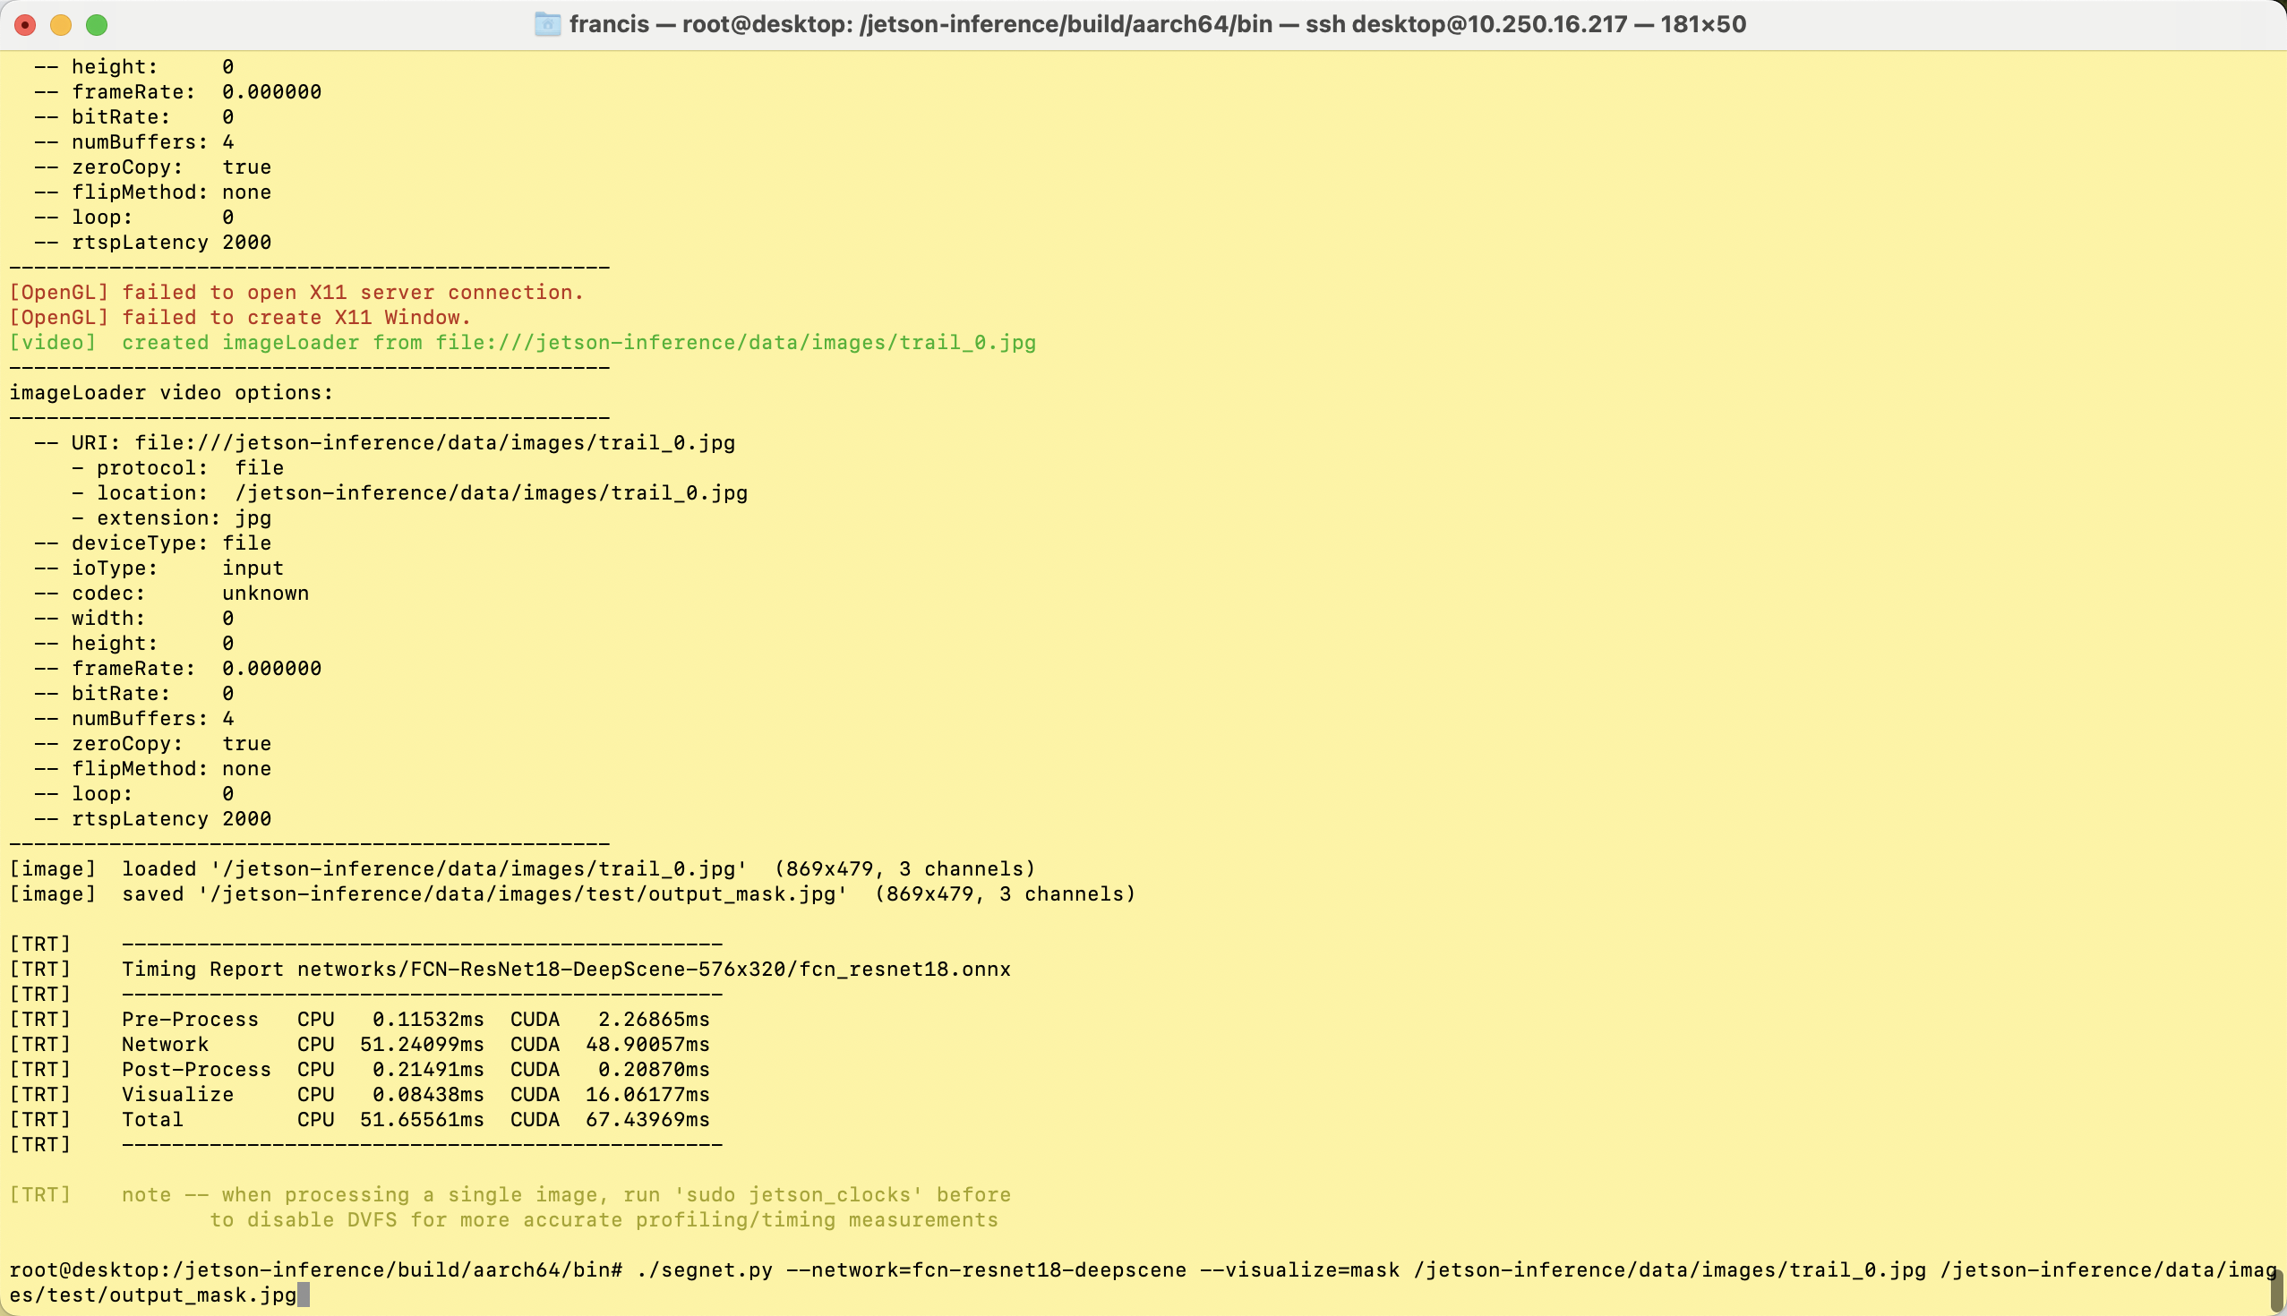
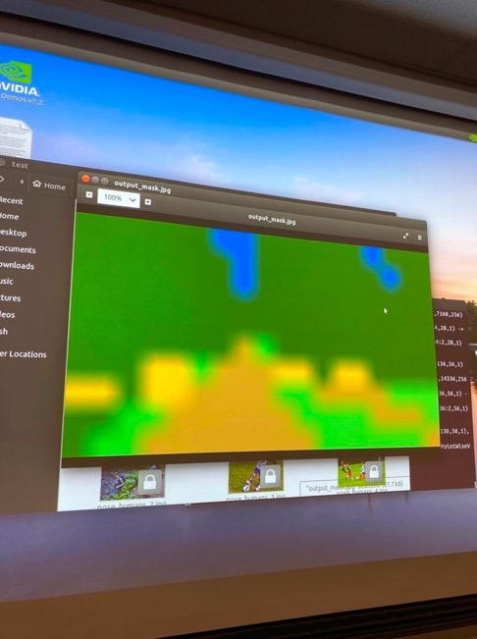
Image Segmentation with fcn-resnet18-deepscene
./segnet.py --network=fcn-resnet18-deepscene --visualize=mask /jetson-inference/data/images/trail_0.jpg /jetson-inference/data/images/test/output_mask.jpg

Slide 18
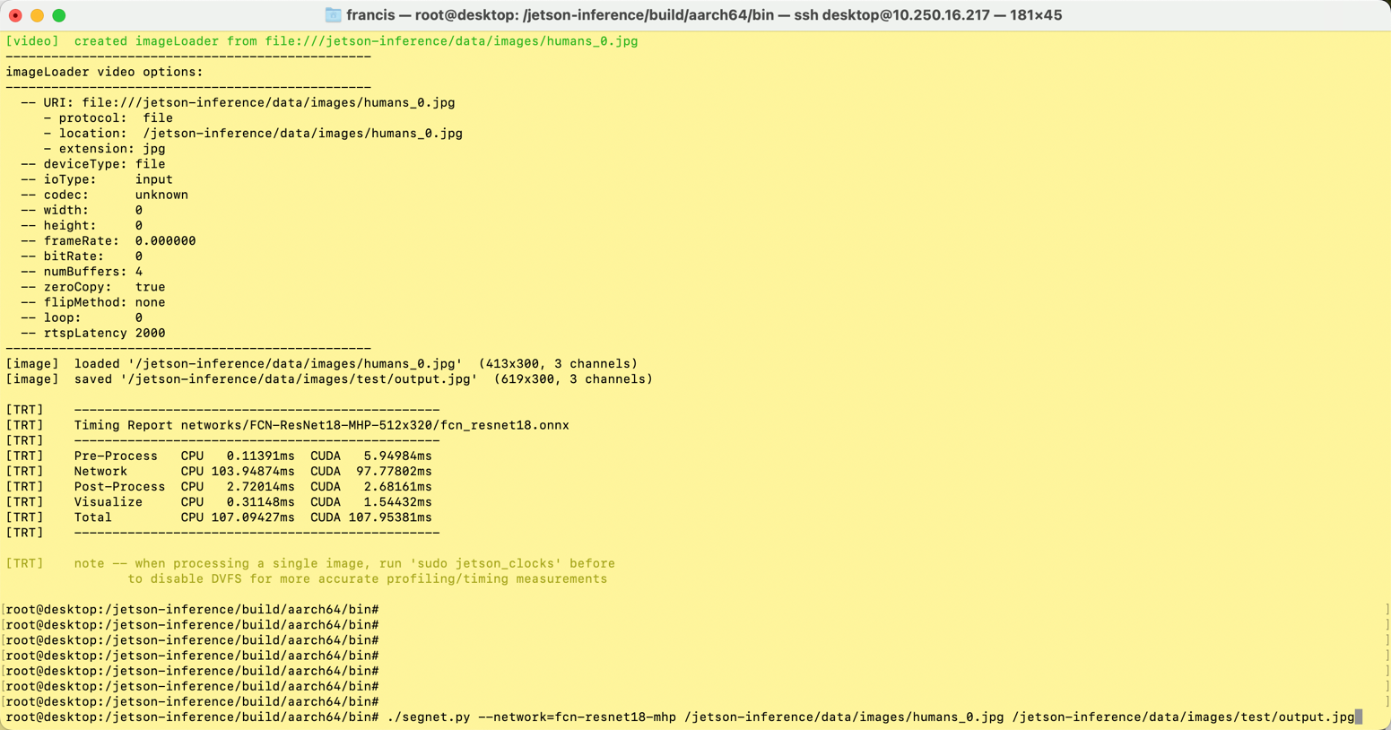
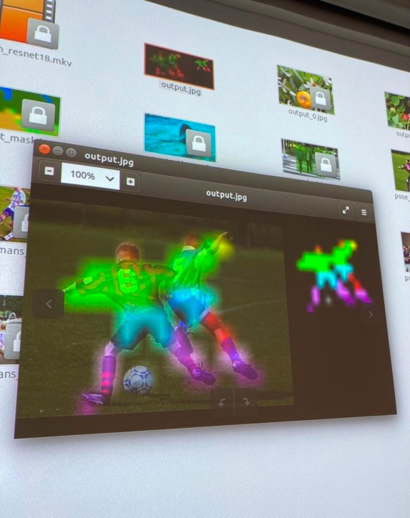
Image Segmentation with fcn-resnet18-mhp
./segnet.py --network=fcn-resnet18-mhp /jetson-inference/data/images/humans_0.jpg /jetson-inference/data/images/test/output.jpg

Slide 19
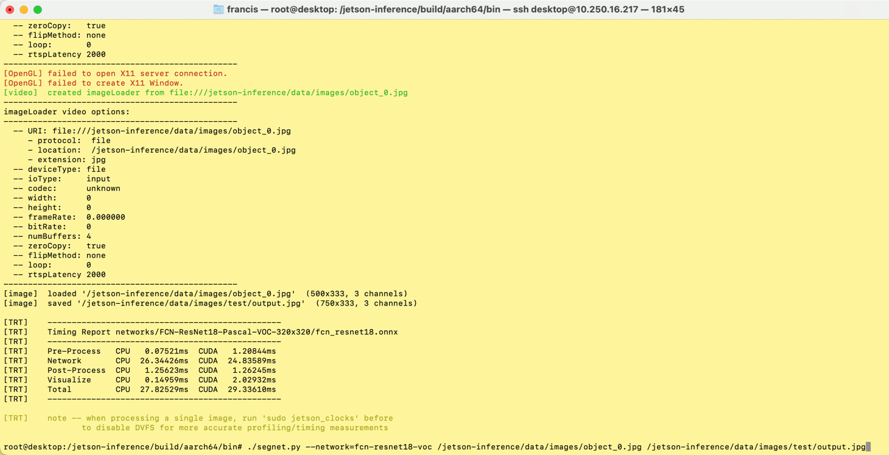
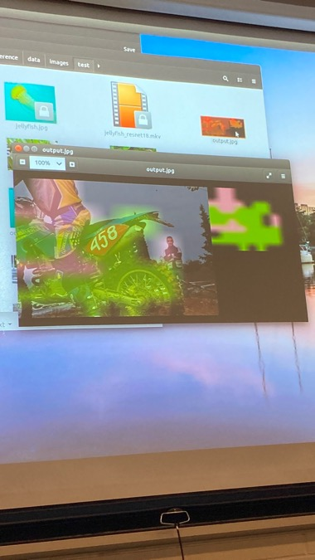
Image Segmentation with fcn-resnet18-voc
./segnet.py --network=fcn-resnet18-voc /jetson-inference/data/images/object_0.jpg /jetson-inference/data/images/test/output.jpg

Slide 20
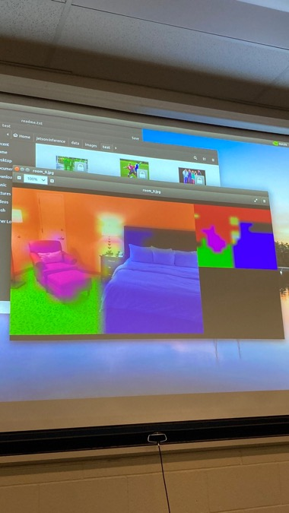
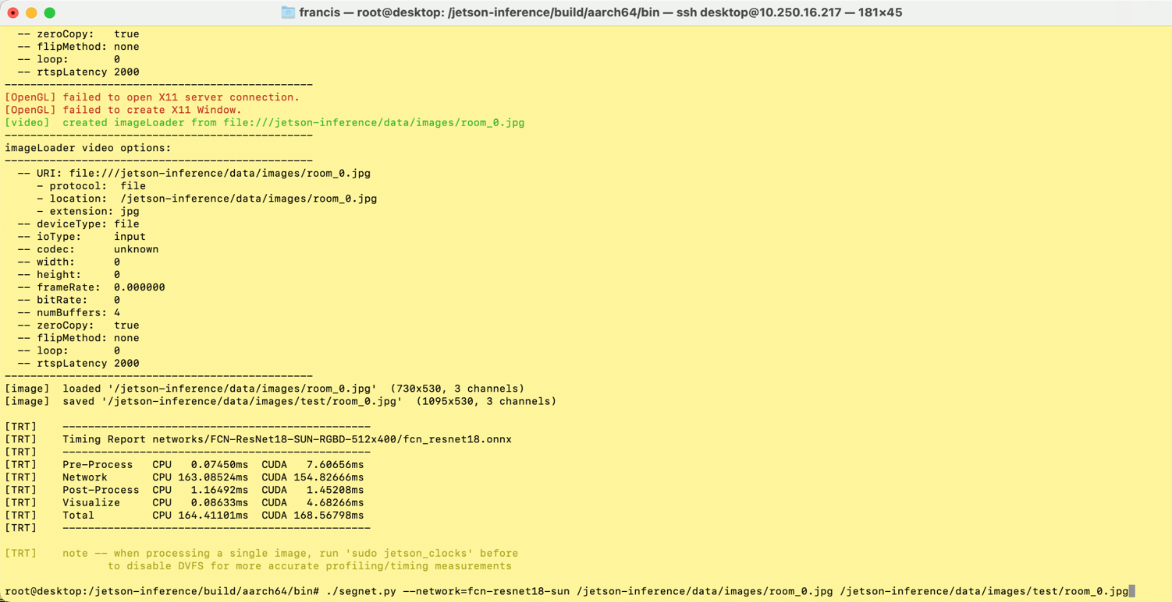
Image Segmentation with fcn-resnet18-sun
./segnet.py --network=fcn-resnet18-sun /jetson-inference/data/images/room_0.jpg /jetson-inference/data/images/test/room_0.jpg

Slide 21
Pose EsTimaTion
Follow the instruction at :
https://github.com/dusty-nv/jetson-inference/blob/master/docs/posenet.md

Slide 22
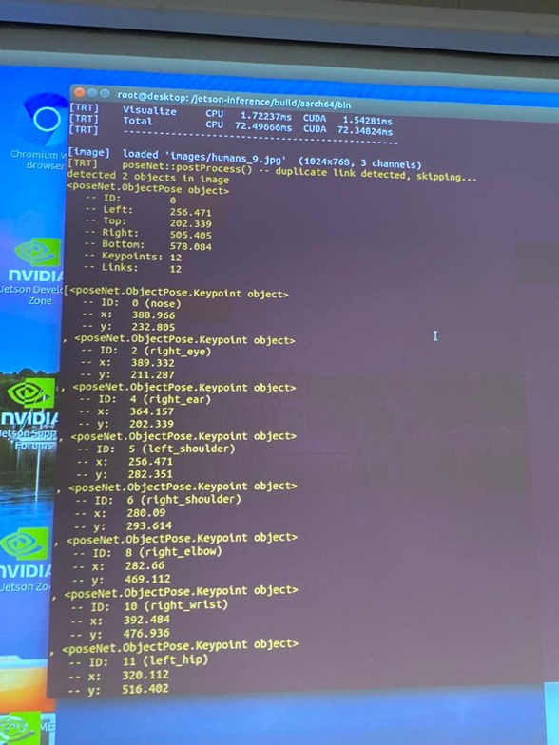
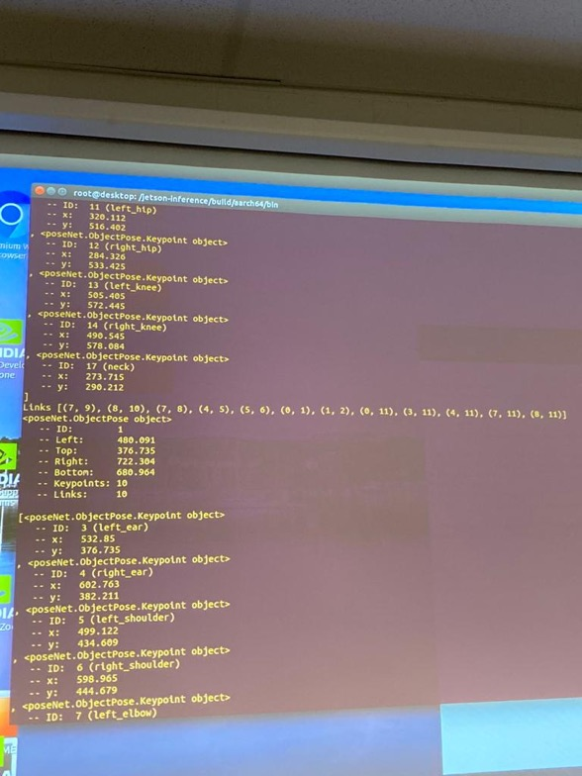
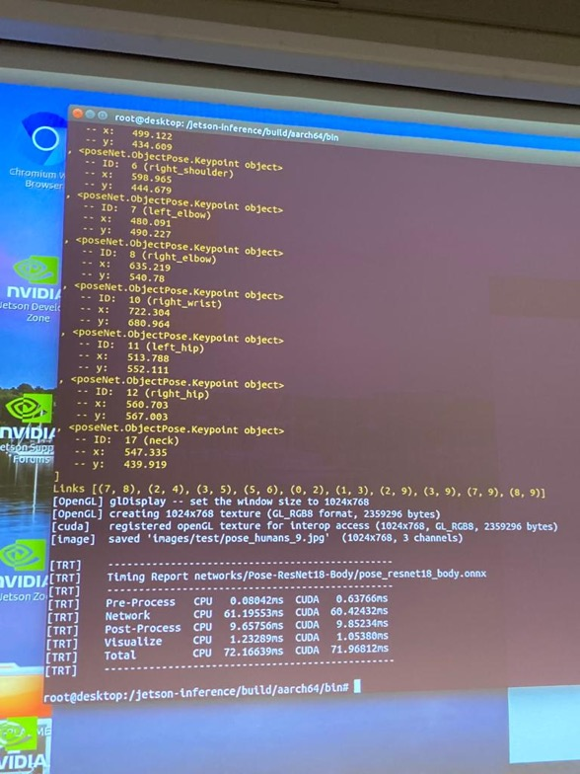
To cover Pose Estimation (Image)
./posenet.py "images/humans_*.jpg" images/test/pose_humans_%i.jpg

Slide 23
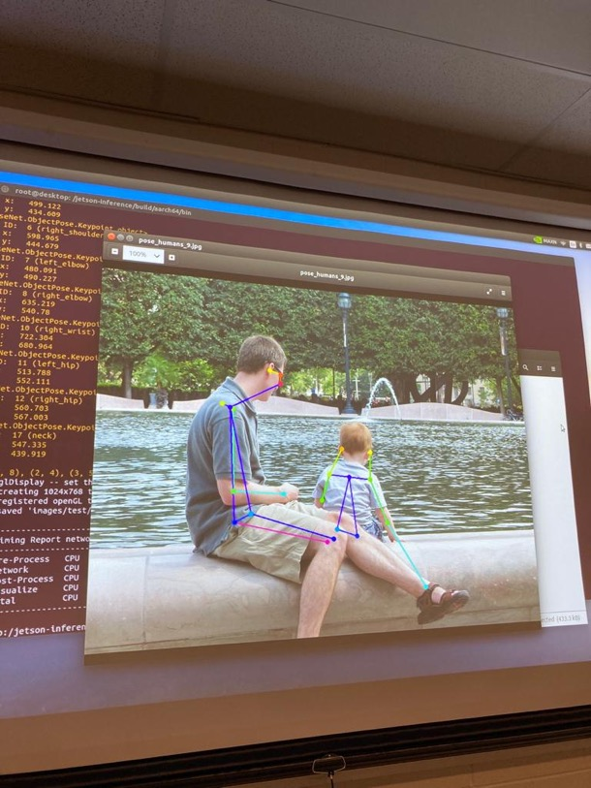
To cover Pose Estimation (Image)
Output:

Slide 24
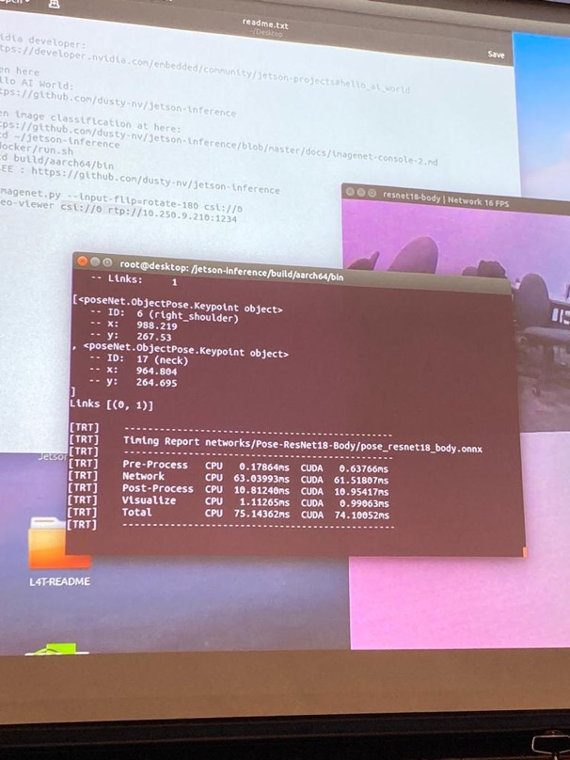
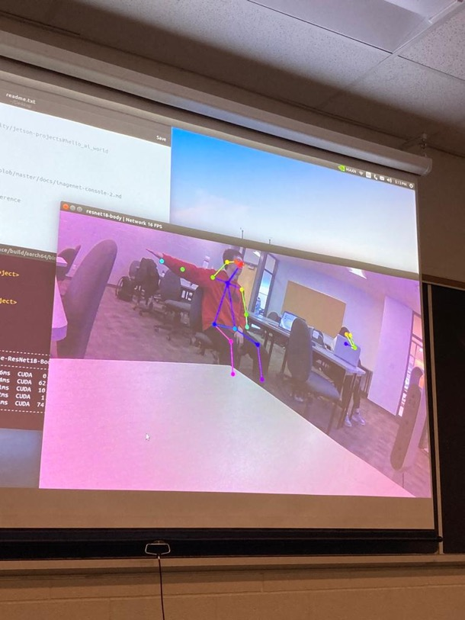
To cover Pose Estimation (Video)
./posenet.py csi://0 rpt://xxx.xxx.xxx:xxxx

Slide 25
Comparisons
Image Classification
Image Segmentation
Pose Estimation

Slide 26
Image Classification vs Image Segmentation vs Pose Estimation (Comparisons)
Image Classification
Category(Predefined)
Supervised Learning
Labeled Dataset
High Accuracy(in larger dataset)
Image Segmentation
Regions(Different)
Supervised Learning
Labeled Dataset
High Accuracy(in larger dataset)
Pose Estimation
Position/Orientation
Supervised/Unsupervised Learning
Sensors/Specialized Hardware
Accuracy Depend on Hardware/Algorithms

